Slide 1


THE ROVER
(AVASARALA RATNAVALLI, HARISH CHANDRA JYOSHI, SAI NAGARJUNA KOLLA, SINDHUJA THOUTULA)

Slide 2
OBJECTIVES
To develop an ionic application that assists the travelers in planning, experiencing and reviewing the tourist attractions through Augmented Reality (AR) by integrating various facilities on a single platform.
This app is also to help tourists overcome the difficulties faced like the language barriers, restaurant/food availabilities, searching nearby attractions which would help them in providing a best travel experience.

Slide 3
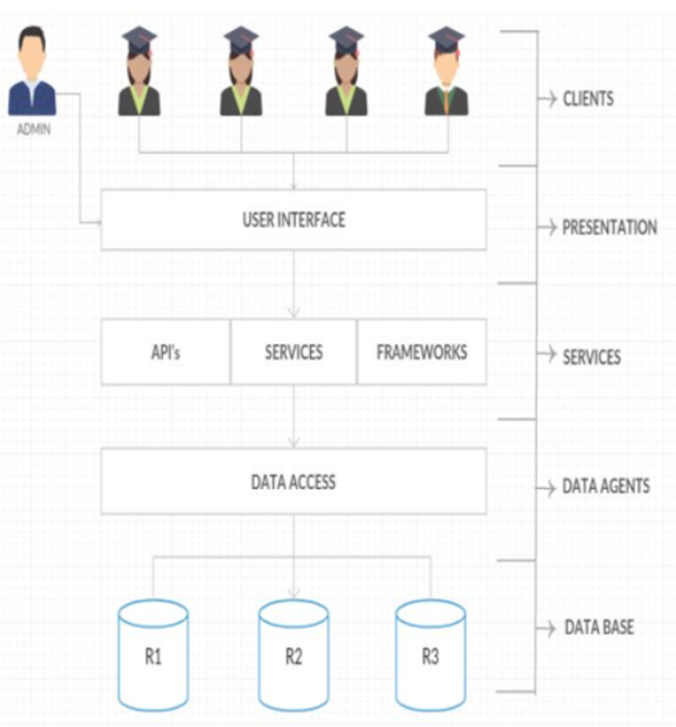
ARCHITECTURE

Slide 4
FEATURES
Using Augmented Reality to get the nearby attractions.
The user can decide whether or not to visit a place by checking it's positive score on sentiment analysis API based on collected Twitter data.
Travelers can use the inbuilt Translate and Visual Recognition APIs when they travel to a different country or a remote location.
Obtain the Weather Forecast even before reaching the destination in an interactive way.

Slide 5
APIS USED
Google GeoLocation
1
Clarifai Visual Recognition
2
Open WeatherMap
3
Translate Yandex
4
Uclassify Sentiment Analysis
5
Wikitude SDK for ionic framework
6

Slide 6








Technologies
Ionic3 framework
NodeJS
Angular JS
HTML5
Firebase
Webstrom
Wikitude
Brackets

Slide 7
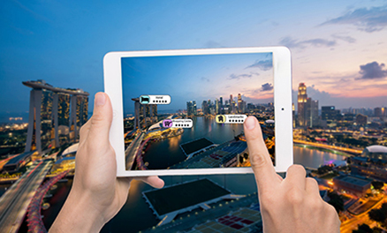
Uniqueness
Implemented AR in Ionic framework
We used the relative locations in AR to obtain the nearby attractions and essentials.

Slide 8
Future scope
Real time navigation using GeoMaps.
Access to Interactive Dining and Entertainment Choices.
To know about any historic location/monument in an interactive way using AR.

Slide 9


